Slide 1
Project Demo
PCA: eigenfaces

Slide 2
PCA: Eigenfaces Demo

Slide 3
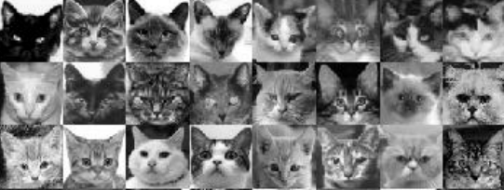
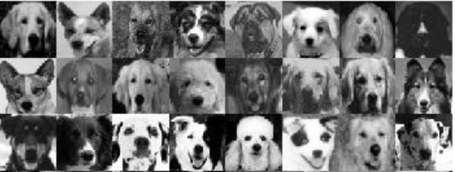
PCA: Eigenfaces Demo
Dataset of N cats/dogs

Slide 4
PCA: Eigenfaces Demo
Dataset of N cats/dogs

Slide 5
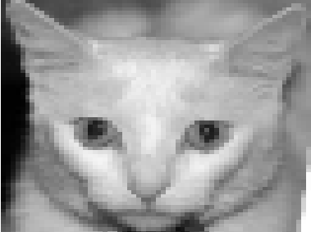
PCA: Eigenfaces Demo
Dataset of N cats/dogs
grayscale cat image of K x K pixels

Slide 6
PCA: Eigenfaces Demo
Dataset of N cats/dogs
grayscale cat image of K x K pixels
Row vector image of 1 x K²

Slide 7
PCA: Eigenfaces Demo
Dataset of N cats/dogs
grayscale cat image of K x K pixels
Row vector image of 1 x K²
Arrange in a matrix where each face = row
.
.
.
N x K² matrix

Slide 8
PCA: Eigenfaces Demo
Dataset of N cats/dogs
grayscale cat image of K x K pixels
Row vector image of 1 x K²
A set of M eigenvectors
each is a linear combination of all images
Arrange in a matrix where each face = row
PCA
.
.
.
.
.
.
N x K² matrix
K² X M matrix

Slide 9
PCA: Eigenfaces Demo
A set of M eigenvectors
each is a linear combination of all images
.
.
.
K² X M matrix

Slide 10
PCA: Eigenfaces Demo
A set of M eigenvectors
each is a linear combination of all images
.
.
.
reshape
By reshaping a single eigenvector
into a K x K matrix
K² X M matrix

Slide 11
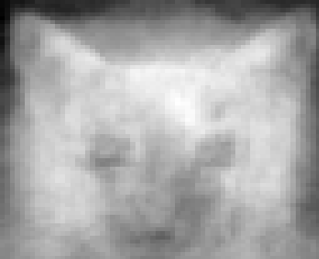
PCA: Eigenfaces Demo
A set of M eigenvectors
each is a linear combination of all images
.
.
.
reshape
By reshaping a single eigenvector
into a K x K matrix
K² X M matrix
We get the first eigenpet

Slide 12
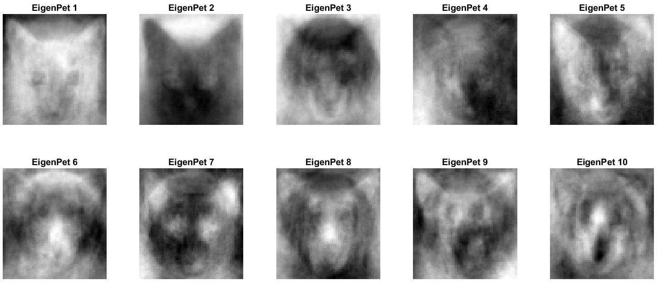
PCA: Eigenfaces Demo
A set of M eigenvectors
each is a linear combination of all images
.
.
.
reshape
By reshaping a single eigenvector
into a K x K matrix
K² X M matrix
We get the first eigenpet
First 10 eigenpets

Slide 13
PCA: Eigenfaces Demo
A set of M eigenvectors
each is a linear combination of all images
.
.
.
reshape
By reshaping a single eigenvector
into a K x K matrix
K² X M matrix
We get the first eigenpet
We can visualize each eigenvector
First 10 eigenpets

Slide 14
PCA: Eigenfaces Demo
A set of M eigenvectors
each is a linear combination of all images
.
.
.
reshape
By reshaping a single eigenvector
into a K x K matrix
K² X M matrix
We get the first eigenpet
We can visualize each eigenvector
Each eigenvector captures certain features
First 10 eigenpets

Slide 15
PCA: Eigenfaces Demo
Reconstruct original image by using K eigenvectors

Slide 16
PCA: Eigenfaces Demo
Reconstruct original image by using K eigenvectors

Slide 17
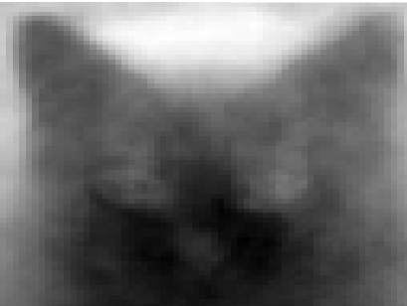
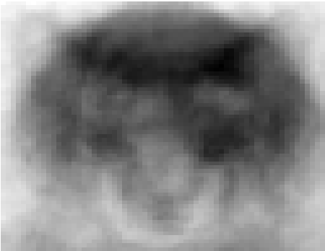
PCA: Eigenfaces Demo
Reconstruct original image by using K eigenvectors
mean
0.6 *
0.45 *
0.9 *
…

Slide 18
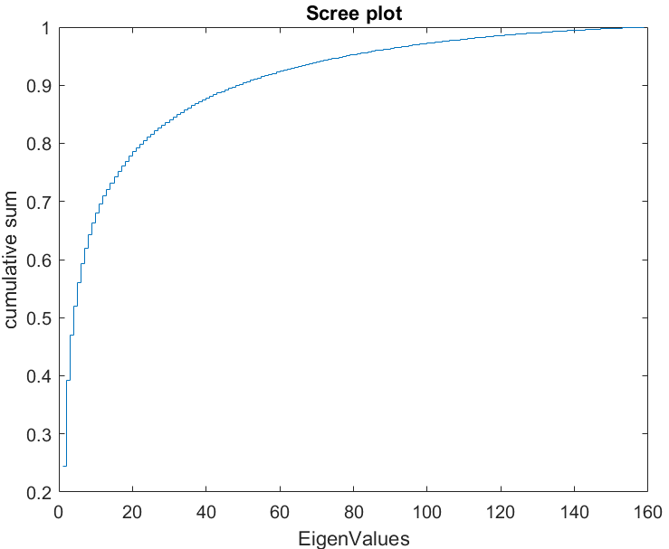
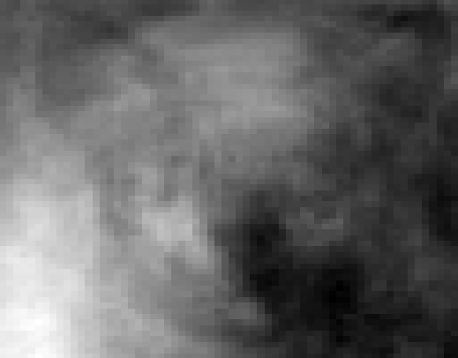
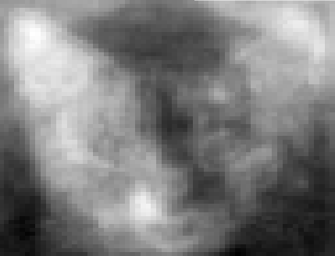
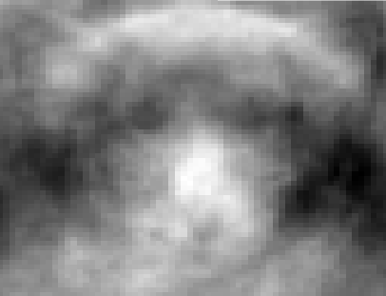
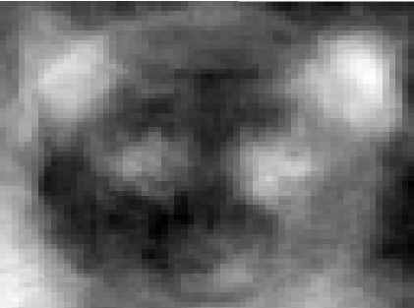
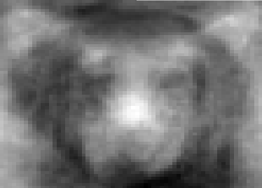
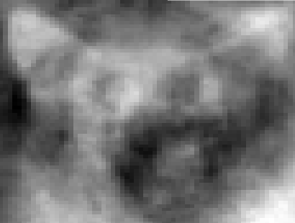
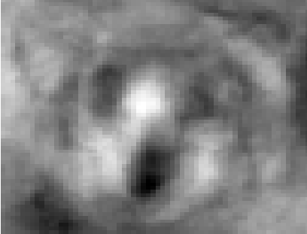
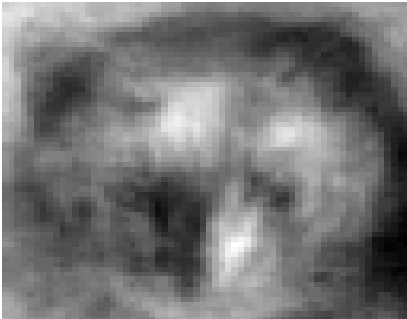
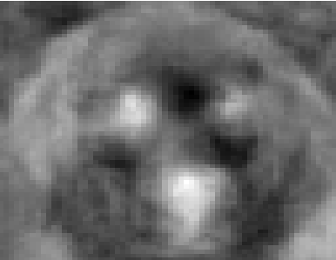
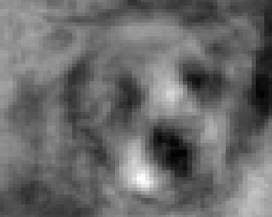
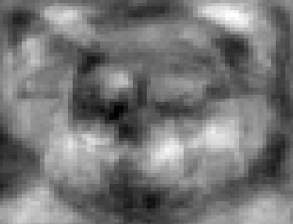
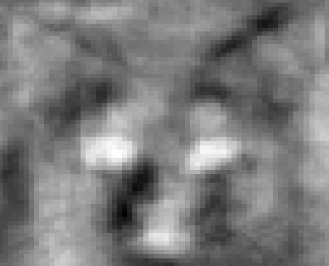
PCA: Eigenfaces Demo
Reconstruct original image by using K eigenvectors
mean
0.6 *
0.45 *
0.9 *
…
Set of M eigenfaces

Slide 19
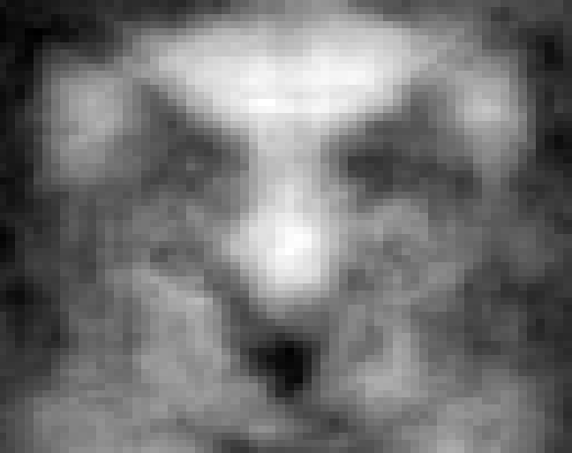
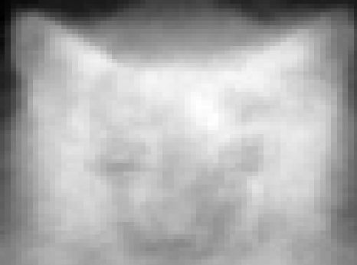
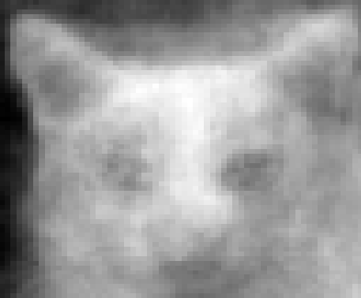
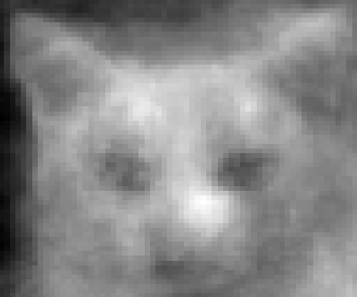
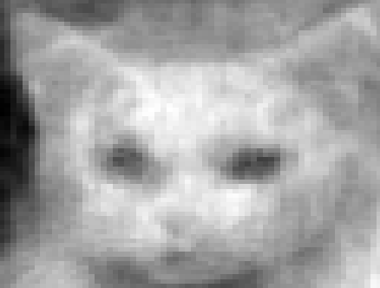
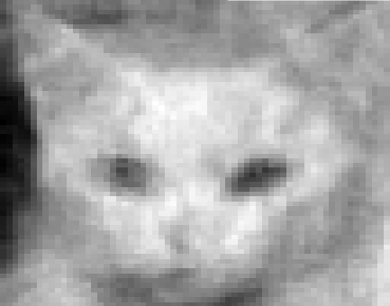
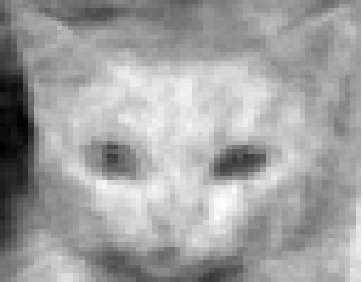
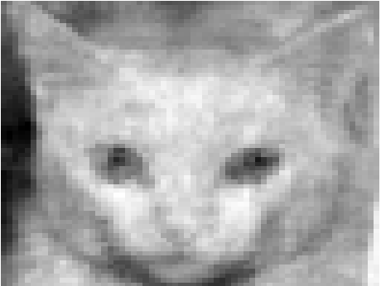
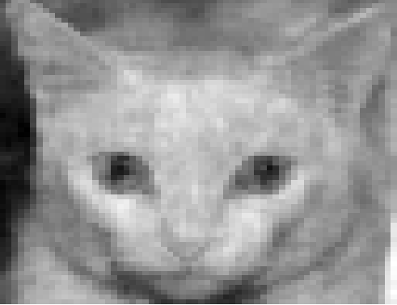
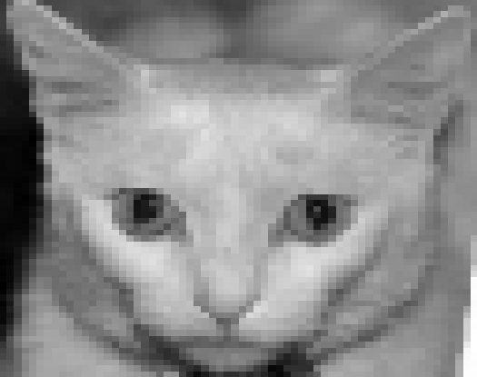
PCA: Eigenfaces Demo
Reconstruct original image by using K eigenvectors
mean
0.6 *
0.45 *
0.9 *
…
Set of M eigenfaces

